Slide 1
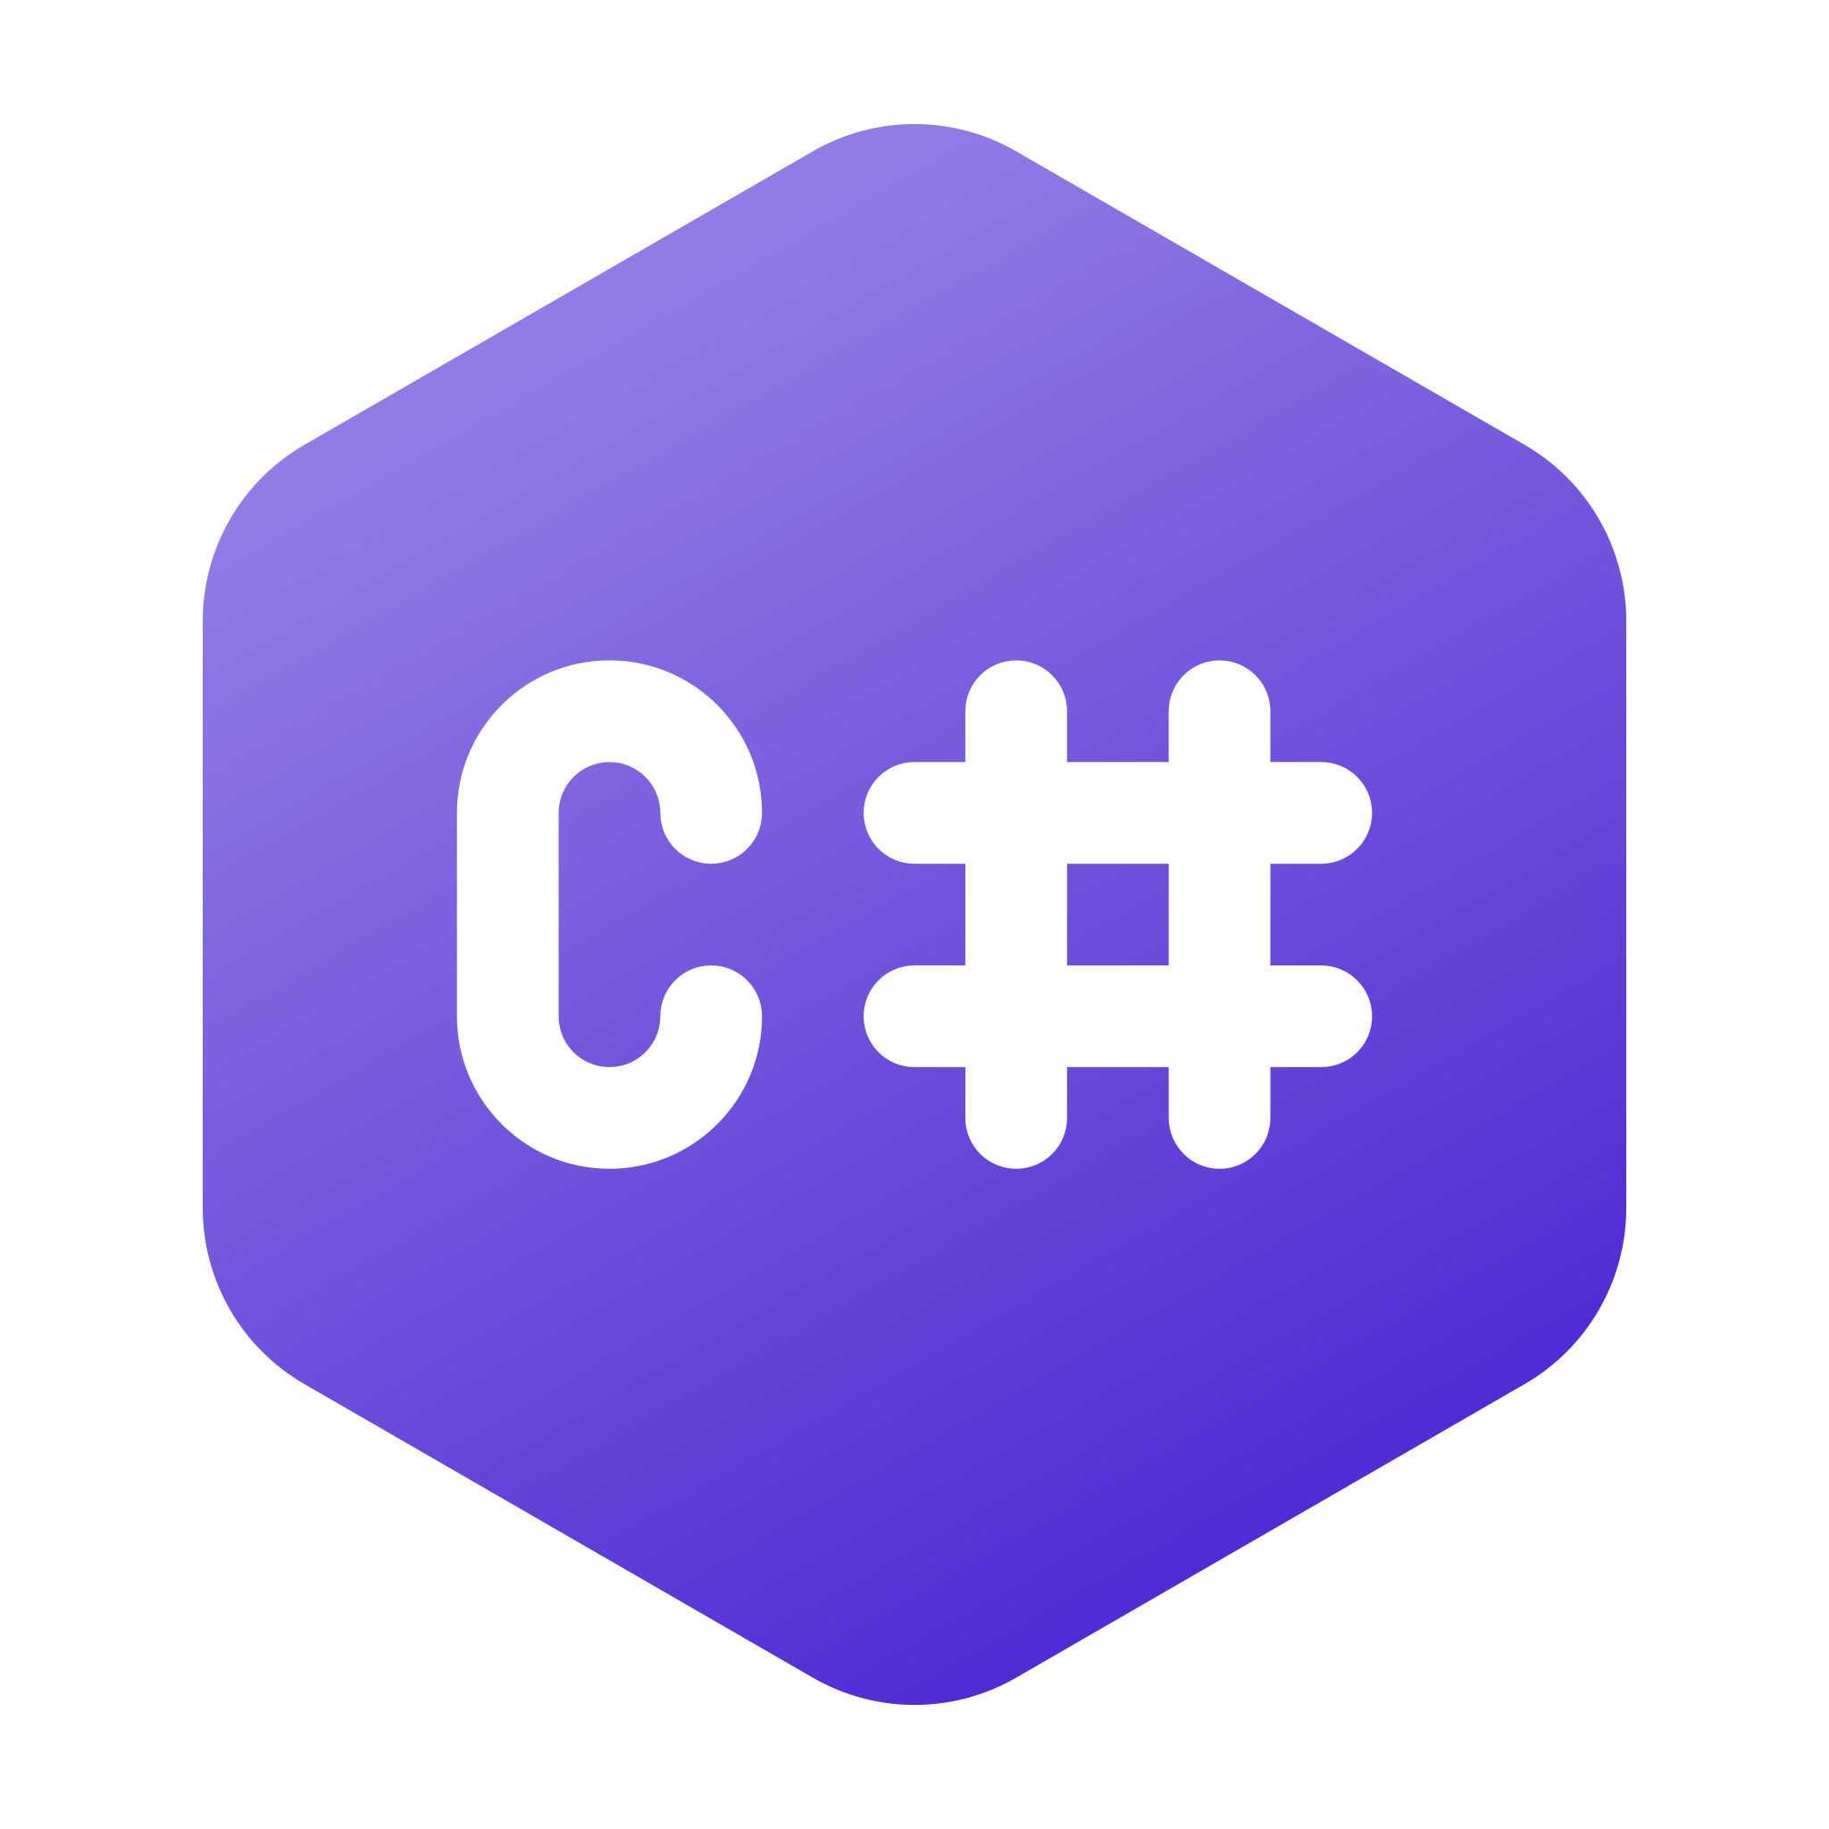
Visual Programming with
Er. Piyush Pant

Slide 2

Er. Piyush Pant
Senior Software Engineer ( Verisk Nepal Pvt. Ltd. )
https://www.linkedin.com/in/epiyushpant/
7 + Years of experience in development and implementation of .NET applications for Nepal governments and US Clients.
MSC in Computer System and Knowledge Engineering
(Pulchowk Campus )

Slide 3
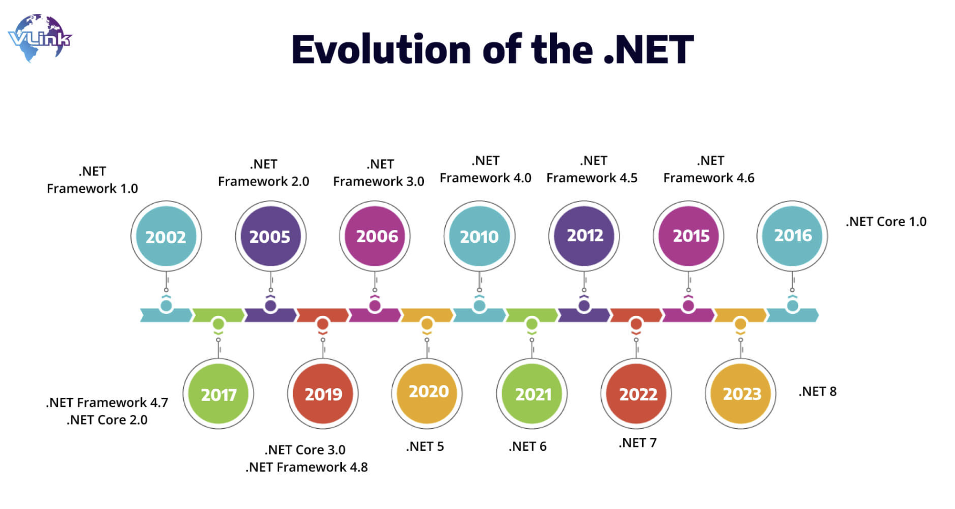
.NET
The .NET is a software development platform created by Microsoft.
Free, cross platform , open source developer platform for building different types of application .
It provides the tools and libraries needed to develop various types of applications, such as web, desktop, and mobile apps.

Slide 4
.NET FEATURES
Multi-Language Support : Supports multiple languages (C#, VB.NET, F#) with seamless interoperability.
Object-Oriented Programming: Promotes modular, reusable, and maintainable code.
ASP.NET for Web Development: Simplifies dynamic web application development.
Automatic Memory Management: Built-in garbage collection for better performance.
Secure Applications: Provides encryption, authentication, and code security.

Slide 5
.NET FEATURES
Rich User Interfaces : Supports advanced graphics and UI (Windows Presentation Foundation).
Database Connectivity : ADO.NET for easy access to databases.
Integration with Visual Studio : Seamless development with debugging and deployment tools.
Common Language Runtime (CLR) : Manages code execution (memory, threads, garbage collection).
Base Class Library (BCL) : Predefined reusable classes for common tasks like file handling, networking, and more.

Slide 6
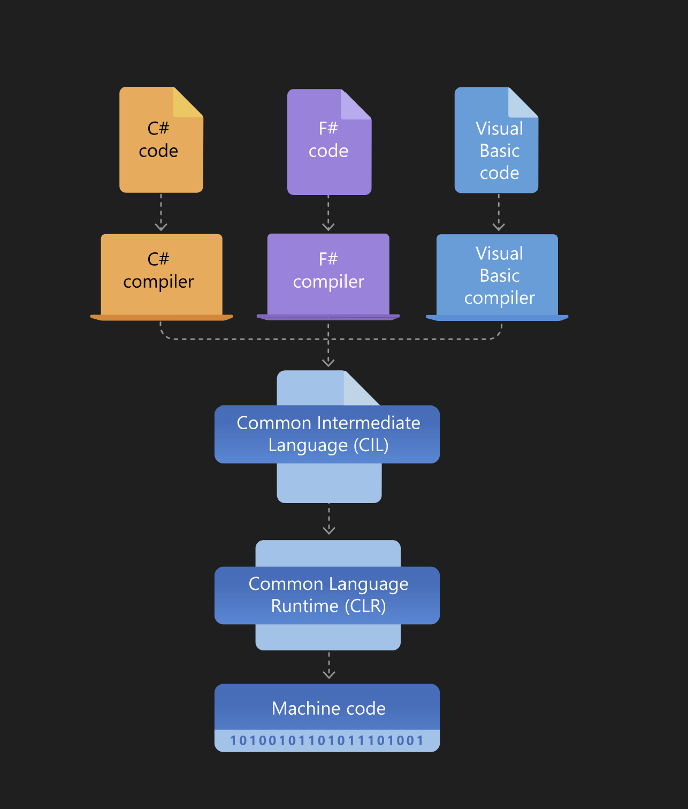
.NET ARCHITECTURE
Major Components : CLR and BCL
CLR (Common language runtime) : is the execution engine that handles running applications. It provides services like thread management, garbage collection, type-safety, exception handling, and more
Base Class Library provides a set of APIs and types for common functionality. It provides types for strings, dates, numbers, etc.
The Class Library includes APIs for reading and writing files, connecting to databases, drawing, and more.

Slide 7
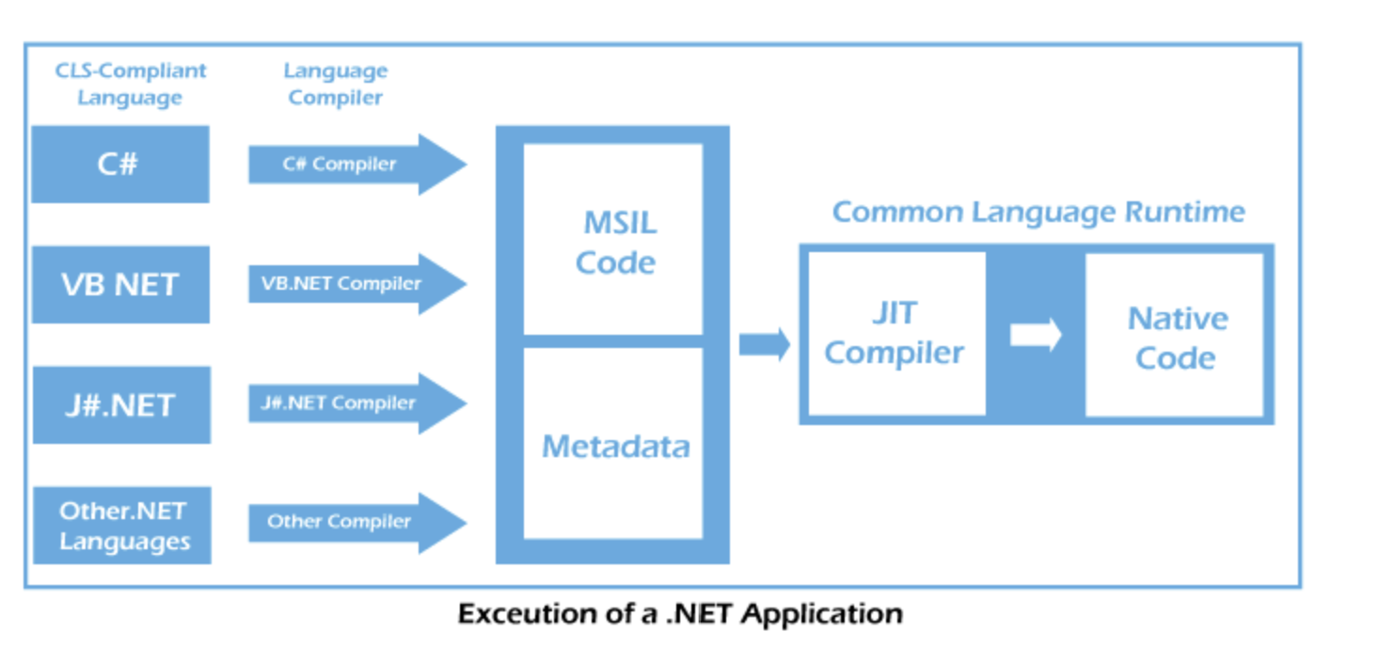
.NET ARCHITECTURE
.NET applications are written in the C#, F#, or Visual Basic programming language. Code is compiled into a language-agnostic Common Intermediate Language (CIL). Compiled code is stored in assemblies—files with a .dll or .exe file extension.
When an app runs, the CLR takes the assembly and uses a just-in-time compiler (JIT) to turn it into machine code that can execute on the specific architecture of the computer it is running on.

Slide 8
NET FRAMEWORK , .NET CORE and .NET STANDARD
.NET Framework
The .NET Framework is a software development framework created by Microsoft in 2002. It provides a consistent programming environment for building and running applications on Windows. It includes a large class library (called the Framework Class Library or FCL) and a runtime environment (called the Common Language Runtime or CLR) for executing applications.
Key Features:
Windows-Only: Designed specifically for Windows-based applications.
Full API Support: Provides extensive libraries and APIs for desktop, web, and server-side applications.
Languages: Supports multiple languages like C#, VB.Net, and F#.
Application Types: Used for building desktop applications, web applications (ASP.NET), and web services.

Slide 9
NET FRAMEWORK , .NET CORE and .NET STANDARD
.NET Core
.NET Core is a modern, open-source, and cross-platform development platform introduced by Microsoft in 2016. It is designed for creating cloud-based, scalable, and high-performance applications that can run on Windows, Linux, and macOS. It is the successor to the .NET Framework and is built to meet the needs of modern development practices.
Key Features:
Cross-Platform: Runs on Windows, Linux, and macOS.
Open Source: Released under the MIT License and maintained by the .NET Foundation.
High Performance: Optimized for scalability and performance, especially for cloud and web applications.
Modular Architecture: Supports lightweight and modular development through NuGet packages.
Versatility: Suitable for web applications (ASP.NET Core), microservices, IoT, and more..

Slide 10
DIFFERENCE
.NET FRAMEWORK
Development and deployment in Windows platform.
Not open source
Performance slow
No Microservice Support
Focus Desktop and web app
.NET CORE
Cross platform development and deployment .
Open Source
Better Performance and scalability
Microservice Support
Focus more on web application

Slide 11
NET FRAMEWORK , .NET CORE and .NET STANDARD
.NET Standard is a set of APIs that defines a common functionality across different .NET implementations (such as .NET Framework, .NET Core, and Xamarin). It ensures that libraries built for one .NET platform can be used across others, providing cross-platform compatibility.
Purpose: Simplifies sharing libraries between platforms without platform-specific code.
In essence, .NET Standard helps make libraries portable across different .NET implementations.

Slide 12
PROJECT TYPES in .NET
Console Applications
Simple, command-line programs without a graphical interface. Great for automation, utilities, or learning.
Web Applications
ASP.NET Core: Modern, cross-platform framework for building dynamic web apps.
ASP.NET Web Forms: Older framework for building web apps (less commonly used today).
Desktop Applications
Windows Forms: Basic desktop apps with a simple user interface.
WPF (Windows Presentation Foundation): Desktop apps with advanced graphics and rich UI elements.
MAUI: Cross-platform apps for Windows, macOS, iOS, and Android, using a single codebase.
Class Libraries
Reusable code that can be shared across different applications. Outputs as a .dll file.

Slide 13
PROJECT TYPES in .NET
Web APIs
APIs that allow different applications to communicate over HTTP, often used for backend services.
Blazor Applications
Web apps that use C# instead of JavaScript. Options include:
Blazor WebAssembly: Runs in the browser.
Blazor Server: Runs on the server with real-time updates to the UI.
Xamarin Applications
Cross-platform mobile apps for iOS and Android using C#.
Microservices
Small, independent services that work together to create scalable and distributed applications.
Azure Functions
Serverless functions for cloud-based, event-driven applications.
Unit Test Projects

Slide 14
CHAPTER TWO

